Slide 1
Eclipse & Java 8 Installation

Slide 2
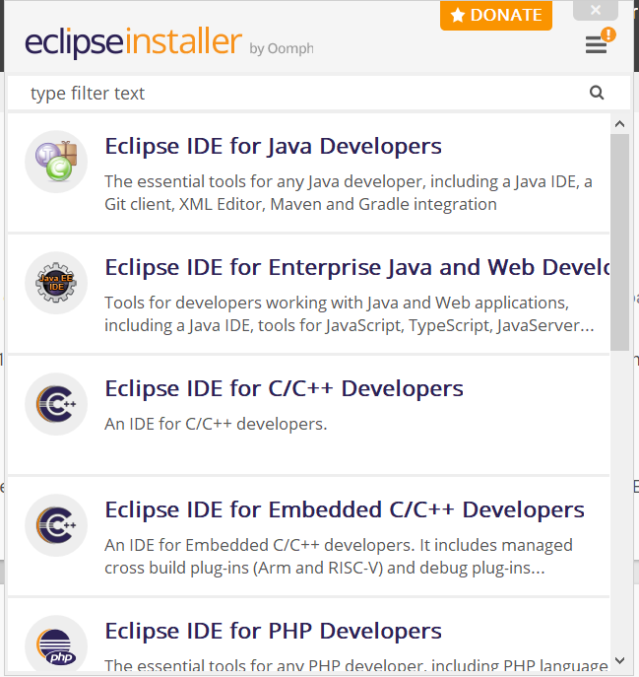
Eclipse Installation
Eclipse is an Integrated Development Environment (IDE) mostly used for Java, but can also be used via plug-ins in other different languages such as C, C++, JavaScript etc..
Download Eclipse from here- https://www.eclipse.org/downloads/
Open the exe file that you just downloaded.
You will see the following window ➔
Choose Eclipse IDE for Java Developers.

Slide 3
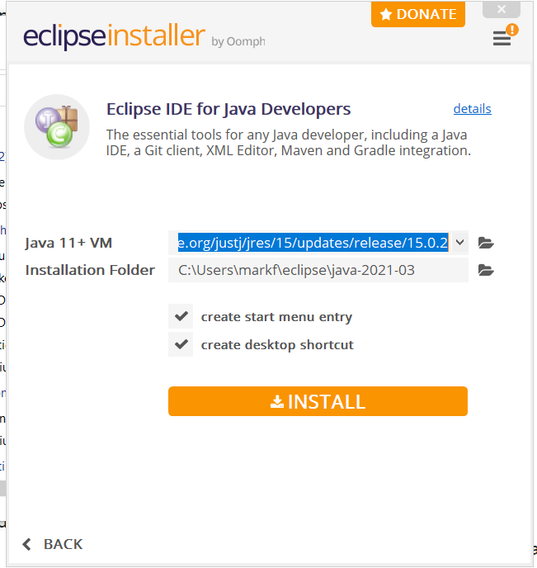
Eclipse Installation
You can leave the default configuration.
Click Install.
Now you have eclipse installed.

Slide 4
JDK 8 Installation
JDK stands for Java development kit.
The JDK allows developers to create Java programs that can be executed and run by the JVM and JRE.
Download JDK 8 from here- https://www.oracle.com/java/technologies/javase/javase-jdk8-downloads.html
After downloading the exe file open it and install JDK 8. You will just need to click continue few times.

Slide 5
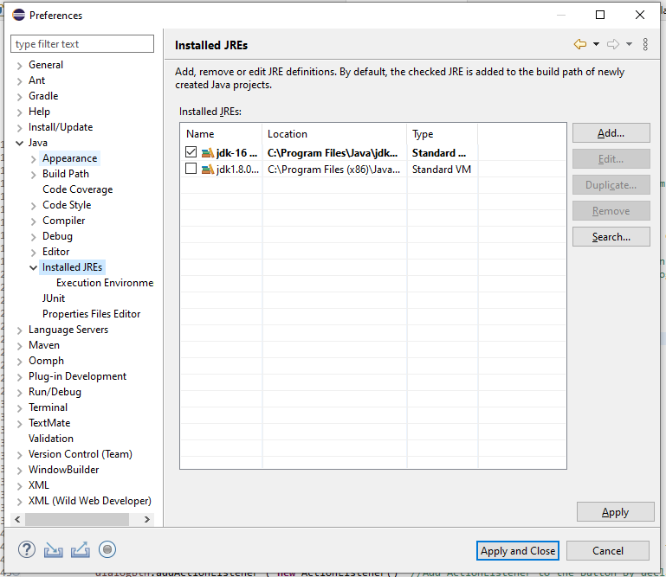
JDK 8 Installation
After the installation is complete open Window on the menu bar in eclipse and click on Preference.
Open Java=> Installed JREs and you will see the following window (With different JDK since it’s not installed yet).
Click on Add, than choose Standard VM

Slide 6
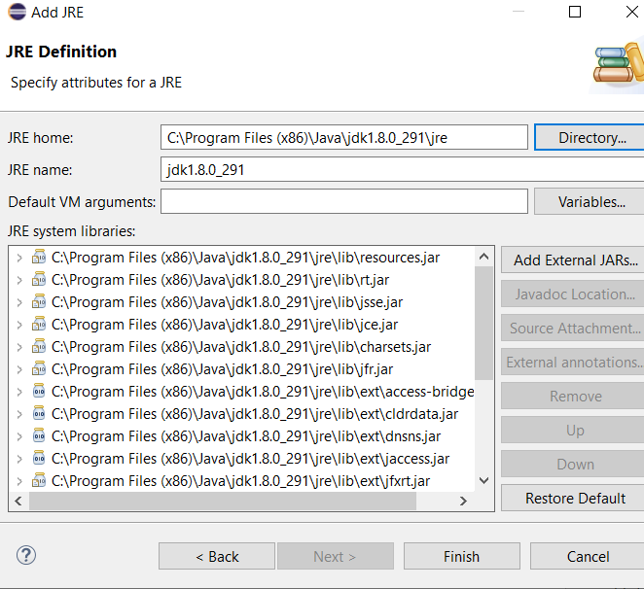
JDK 8 Installation
Now you will see this window ➔
Set the path to the jre directory inside the JDK that you just installed.
Click Finish.
You are ready to start programming.

